Slide 1
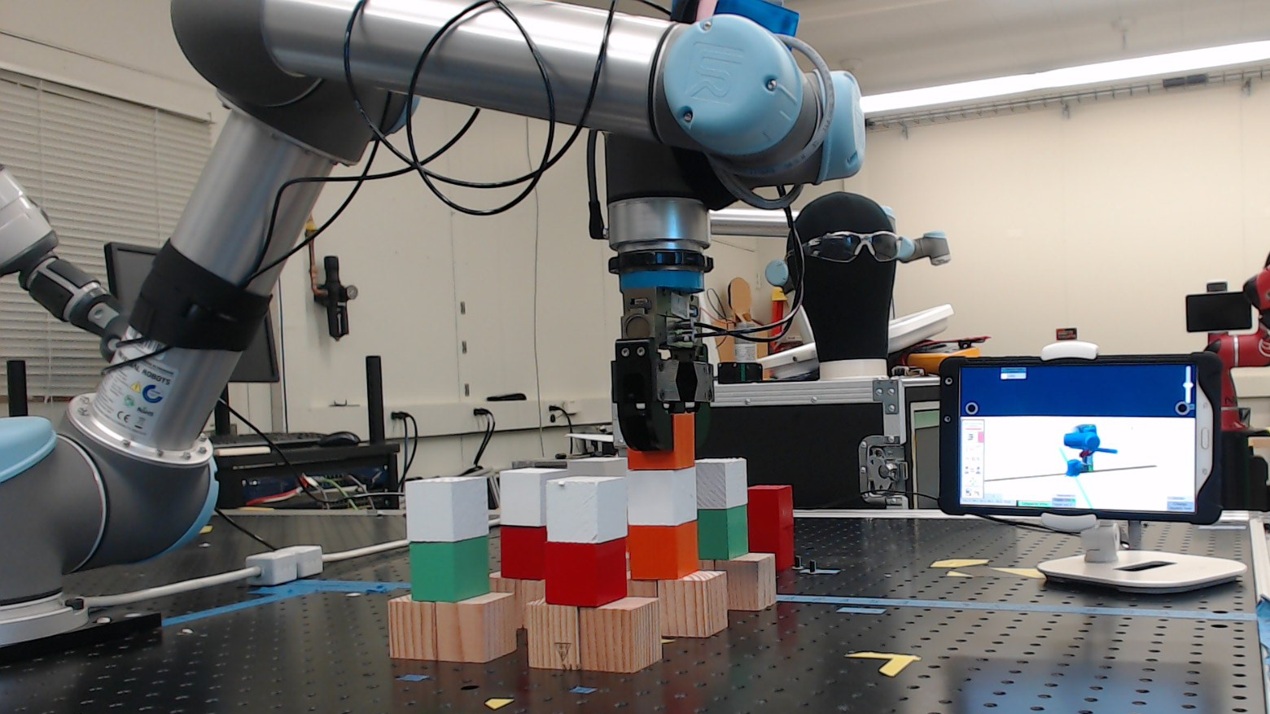
Adaptive Metrics and Performance Analysis Tool for Human-Robot Interaction
Author: Esteban Segarra Martinez; Mentor: Dr. Jeremy Marvel

Slide 2
Introduction
Collaborative Robotics is an emerging field of robotics where the core concept is improving the social interaction between human and robot.
This is usually known as human-robot interaction (HRI); the interaction between robot and human and the feedback between each other
NIST is creating test methods and metrics that can quantify the user experience between human and robot.
NIST Engineering Laboratory

Slide 3
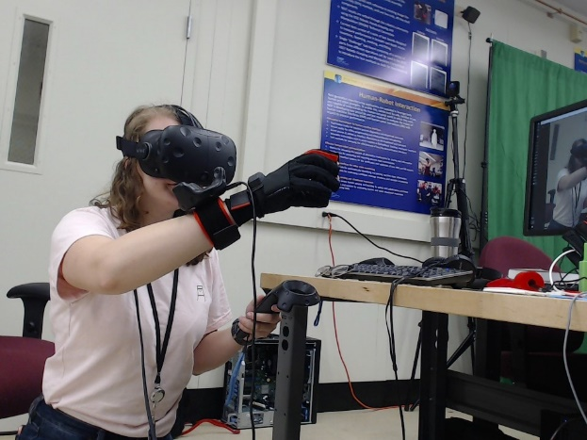
Background
The quality of HRI depends on the effectivity of human-machine interfaces (HMI) to provide reliable information to the operator
HRI is important to cut down on training costs (including time), improve factory floor retasking times, and reduce the amount of mental workload while utilizing a robot’s HMI
HMI is used by an operator for control and feedback on a robot system and varies widely in operation and appearance
Figure 1 – Example of a state-of-the-art HMI
NIST Engineering Laboratory

Slide 4
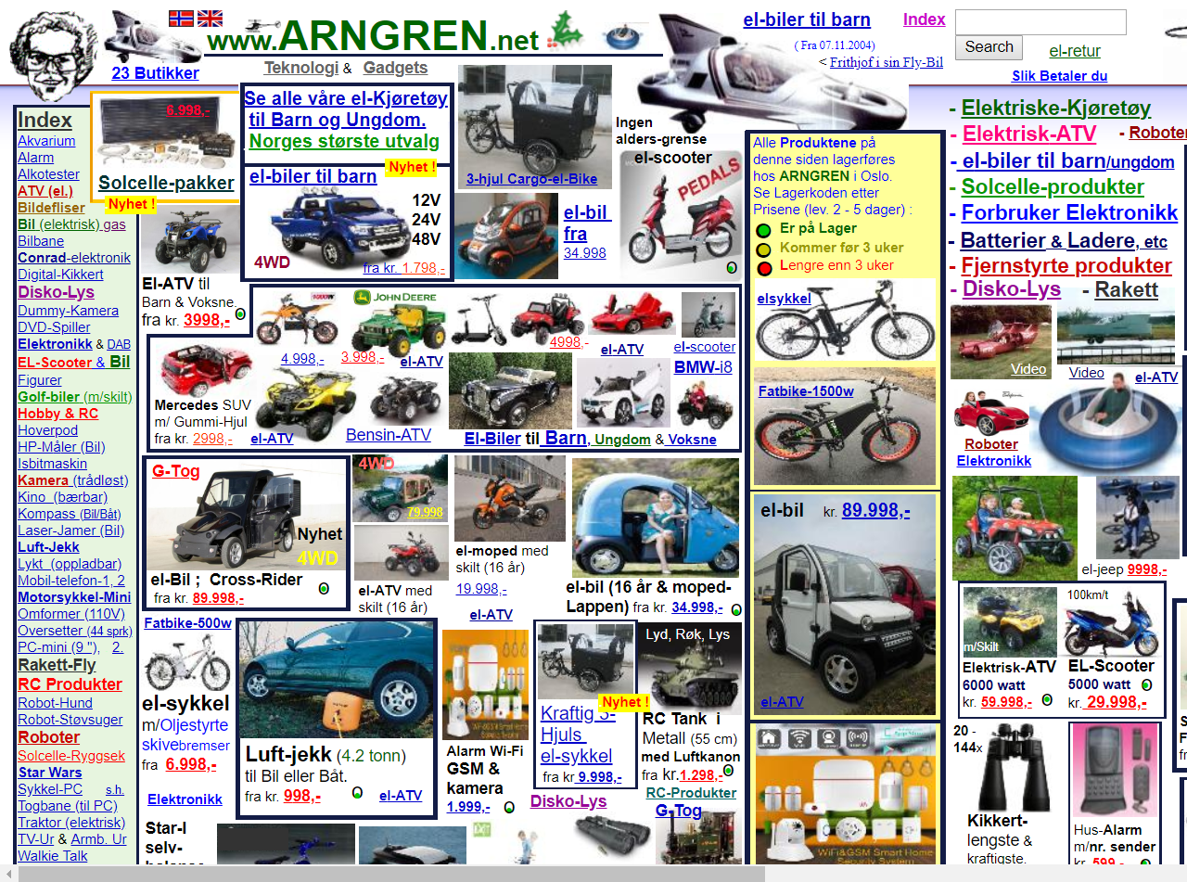
Objective
Create a tool capable of quantifying the effectivity and performance of a HRI interface as would be used by novice user with an industrial robot
Demonstrate the differences between a good UI and a poorly designed one and determining best practices
Through application of an industrial case study, showcase the difference in performance from using a good UI in contrast to current industry standards
Figure 2 – Convoluted UI design
NIST Engineering Laboratory

Slide 5
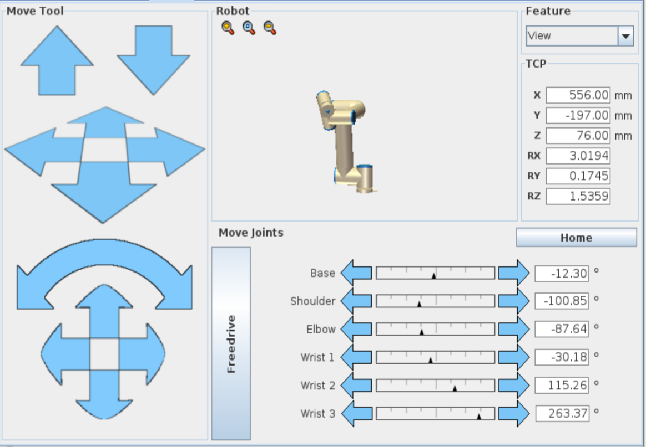
Figure 3 – UI design choice for an industrial robot
NIST Engineering Laboratory

Slide 6
Methodology
To determine good quantitative metrics for HMI, different types of interfaces should be designed. These interfaces should allow the user to experience different features of the interaction or task.
Researchers can determine what features of control, feedback, and overall layout would work most effectively for users using the interface by experimenting with different layouts and measuring for one of the following metrics
Effectiveness
Efficiency
Reaction time
Precision of control
Researchers can test for these metrics by presenting a user interface to a novice or people with no prior experience to an interface with a robot and determine its ease through the reaction the user has.
NIST Engineering Laboratory

Slide 7
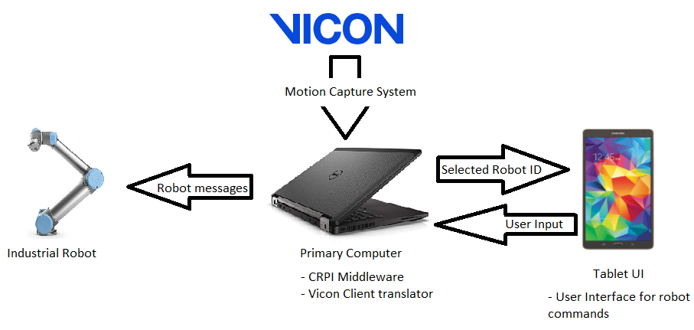
Setup
Figure 4 – System Overview breakdown
NIST Engineering Laboratory
Notes:
Collaborative Robotics Programming Interface (CRPI) allows the computer to relay commands from the tablet to the robot arm
Unity instance calculates the position of items and determines what robot is the user looking at

Slide 8
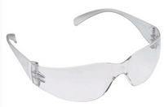
Setup
An operator would wear safety glasses with motion capture dots to stare at robots to initialize them
With this relatively simple system, researchers will be able to determine metrics for the system based on feedback from different interfaces and polling users who test the system
Figure 4 – Eyeglasses used by an operator to use the motion capture system
NIST Engineering Laboratory

Slide 9
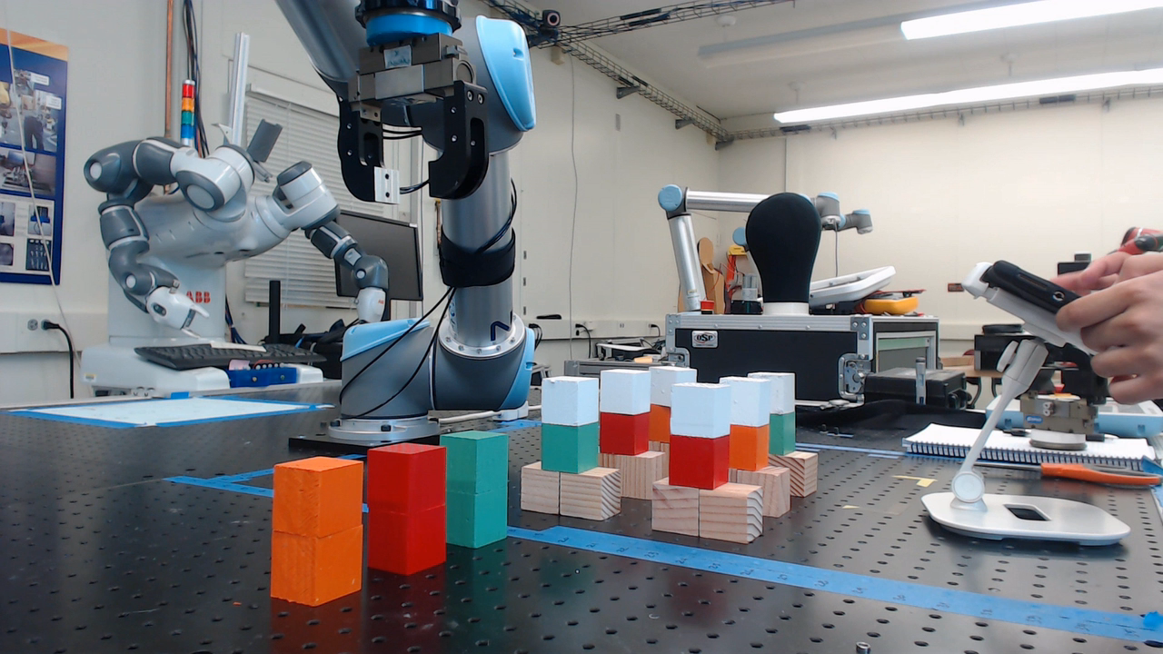
Video Demonstration
NIST Engineering Laboratory

Slide 10
Final Interface
The final UI design is capable of simulating good control schemes and bad control schemes
The controls being relayed from the tablet to the robot can be carried out in real-time via CRPI
The motion capture system can be used as an alternate system for controlling the robot
NIST Engineering Laboratory

Slide 11
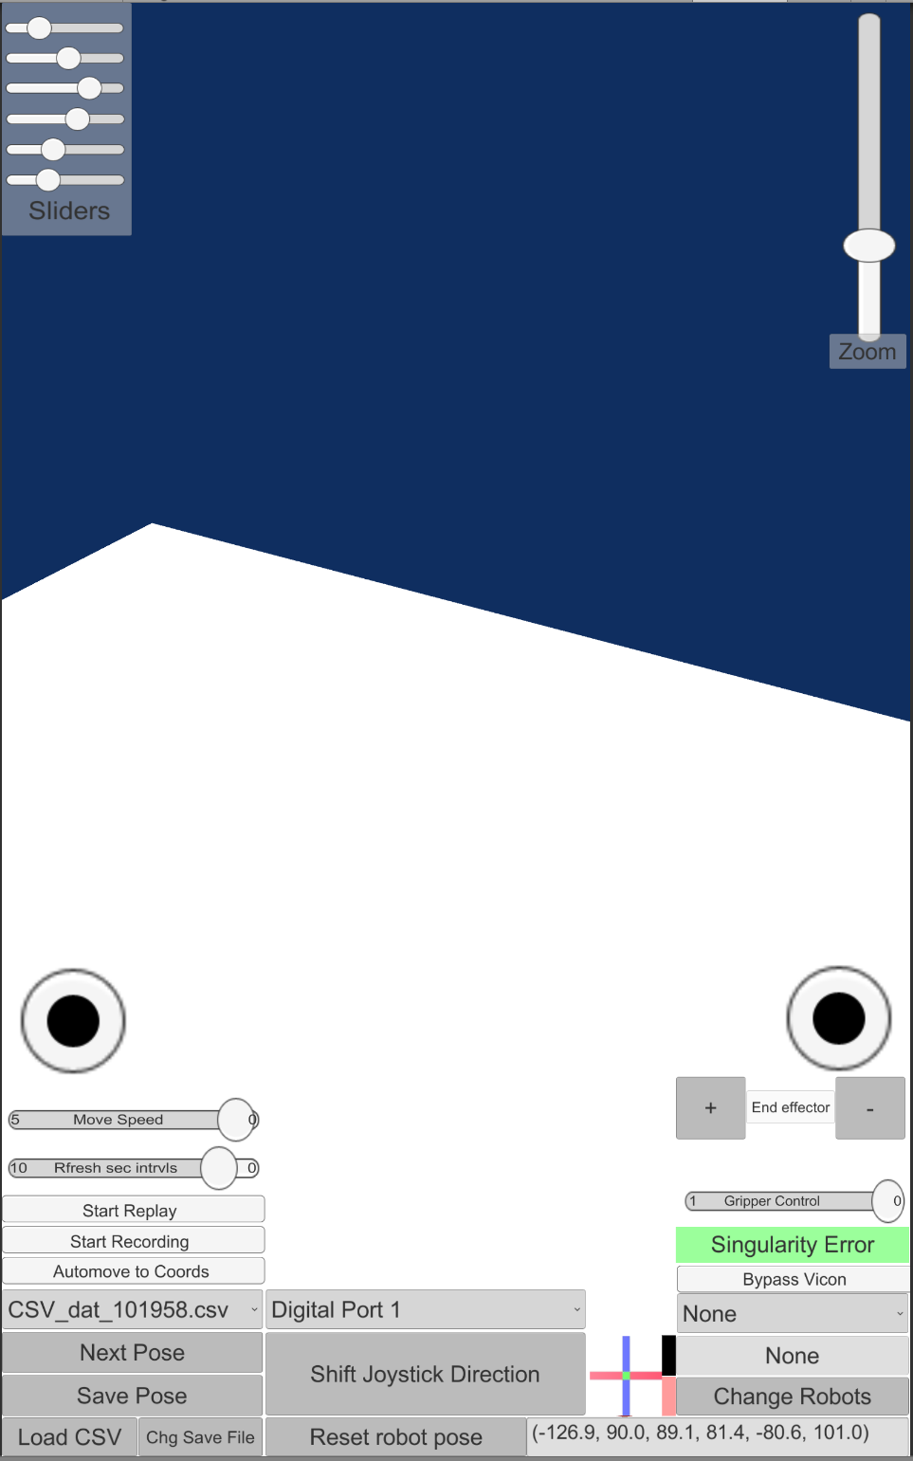
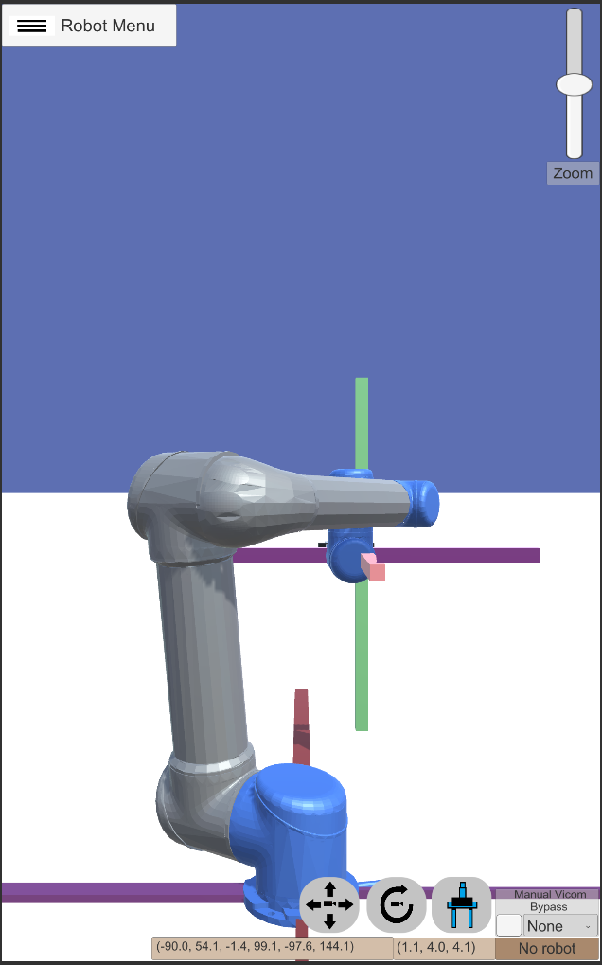
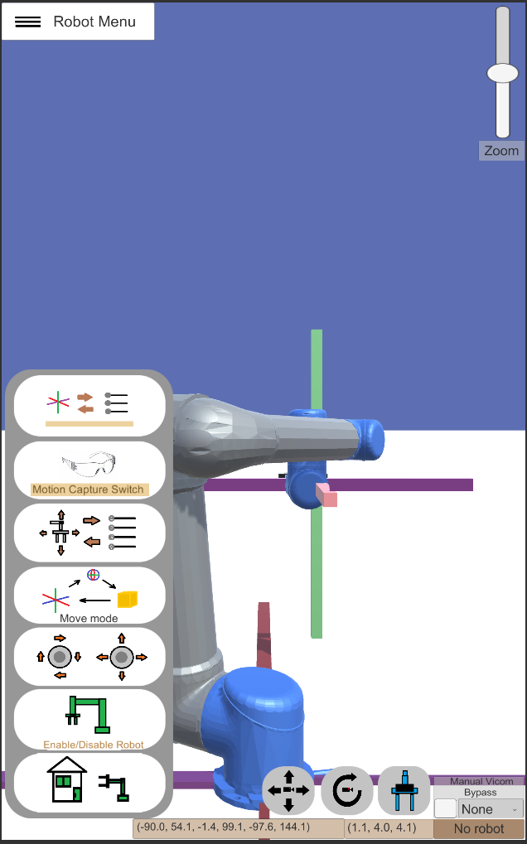
Figure 7 – Example of a poor interface
Figure 8 and 9 – Example of a Structured Interface
NIST Engineering Laboratory

Slide 12
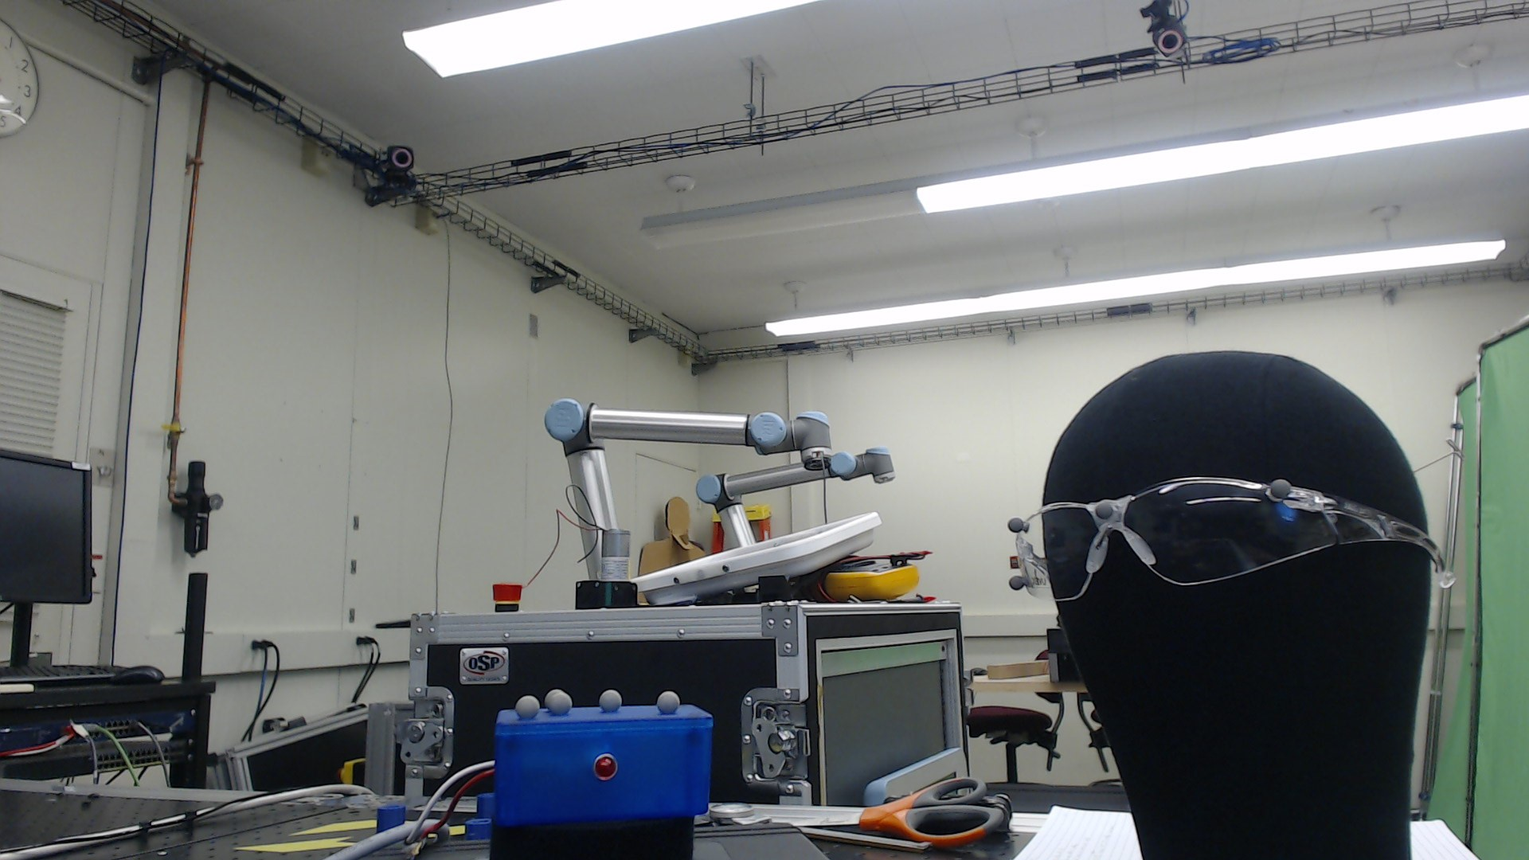
Motion Capture Setup
Motion Capture System
Motion Capture Objects
Figure 10 – Motion capture parts
NIST Engineering Laboratory

Slide 13
Motion Capture Video

Slide 14
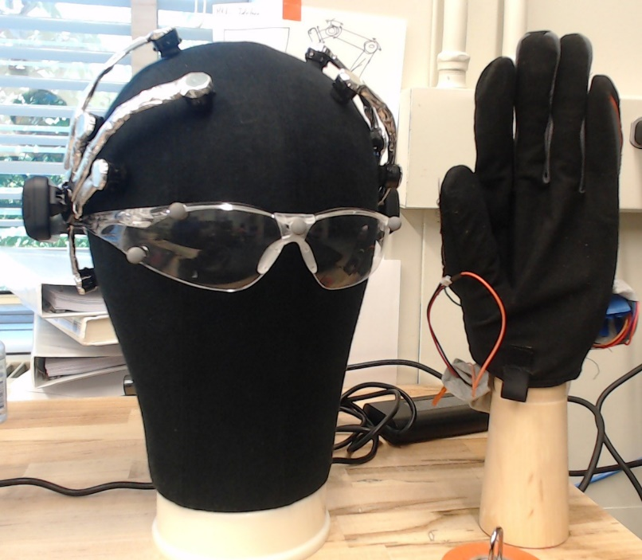
Conclusion and Future Work
NIST will be conducting human trials to obtain more conclusive results on these technologies
These studies will be looking at the use of state-of-the art technologies such as virtual reality, augmented reality, brain-computer interface (BCI), or wearable technologies
Future work will narrow down which types of technology can potentially allow users to control a robot more easily or in a more natural manner
Figure 11 – Examples of future testing equipment including wearable and brain interface technologies
NIST Engineering Laboratory

Slide 15
Questions?
Special thanks to:
Jeremy Marvel
Shelly Bagchi
Megan Zimmerman
Project Files are available on GitHub
https://github.com/usnistgov/CRPI
https://github.com/OvercodedStack/ANDROID_UNITY_UI-Summer-2019-NIST/tree/Android-Branch
https://github.com/OvercodedStack/MOTION_CAPTURE_UNITY-Summer-of-2019-NIST
https://github.com/OvercodedStack/CRPI_MIDDLEWARE_INTEGRATION-Summer-of-2019-NIST
https://github.com/OvercodedStack/CRPI-UI-DOCUMENTATION-Summer-of-2019
Thank you for NIST SURF 2019!

Slide 16
NIST Disclaimer
Certain commercial equipment, instruments, or materials are identified in this paper to foster understanding. Such identification does not imply recommendation or endorsement by the National Institute of Standards and Technology, nor does it imply that the materials or equipment identified are necessarily the best available for the purpose.
NIST Engineering Laboratory

Slide 17
References for Images
Amazon.com for image for Latitude E5570
Universal Robotics for UR5 image
NIST Engineering Laboratory

